Slide 1
Dynamic programming: Optimal binary search tree
Session 18
Henry Lucky, S.Kom. M.Kom.

Slide 2
Outline Materials
Session 18
Optimal binary tree problem
Solving optimal binary tree problem

Slide 3
Learning outcomes
LO 1: Explain fundamental concept of analysis algorithms
LO 2: Apply algorithm techniques and methods
LO 3: Solve a problem using specific algorithm.
LO 4: Compare several algorithm design methods

Slide 4
Optimal binary tree problem
Definition
The objective of the optimal binary search tree problem is to minimize the expected search cost.
The search cost is determined by the depth of the nodes in the tree that need to be traversed to find a key.
Since the search costs depend on the probabilities of searching for different keys, finding an optimal binary search tree involves considering both the structure of the tree and the associated probabilities.

Slide 5
Optimal binary tree problem
Definition
Formally, given a set of keys K = {k1, k2, ..., kn} of n distinct keys such that k1 < k2 < … < kn, build a binary tree containing them.
For each ki, you are given the probability pi.
Since some searches may be for values not in K, you also have n + 1 dummy keys d0, d1, …, dn representing those values.
d0 represents all values less than k1, dn represents all values greater than kn.
For each dummy key di, you have the probability qi.
Each key ki is an internal node and each dummy key di is a leaf

Slide 6
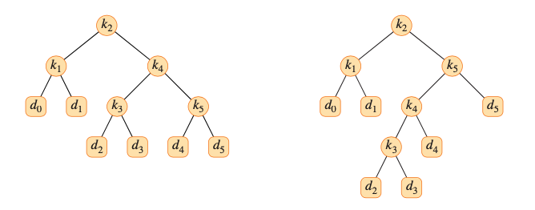
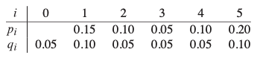
Optimal binary tree problem
Definition
d
Cost = 2.8
Cost = 2.75
OPTIMAL

Slide 7
Optimal binary tree problem
Definition
The expected cost of a search in binary tree T is:
The goal is to construct a binary search tree with minimum expected search cost.

Slide 8
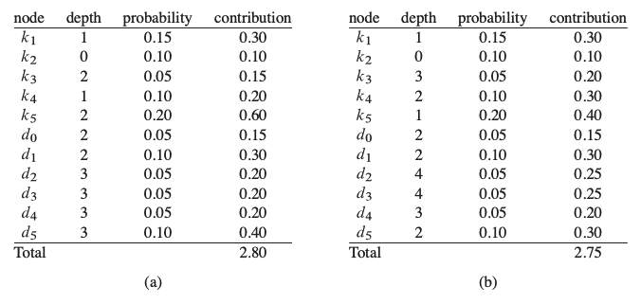
Optimal binary tree problem

Slide 9

Optimal binary tree problem
Just like problems before, exhaustive checking of all possibilities fails to yield an efficient algorithm.
You can label the nodes of any n-node binary tree with the keys to construct a binary search tree, and then add in the dummy keys as leaves.
The number of binary trees with n nodes is $Ω(4^{n}/n^{3/2})$.
Thus you would need to examine an exponential number of binary search trees to perform an exhaustive search.

Slide 10
Solving optimal binary tree problem
Step 1: The structure of optimal BST
Consider any subtree of a binary search tree. It must contain keys in a contiguous range k₁, ...,k_{j}, for some 1 ≤ i ≤ j ≤ n. In addition, a subtree that contains keys k_{i}, ..., k_{j} must also have as its leaves the dummy keys d_{i-1}, ..., d_{j}.
If an optimal binary search tree T has a subtree T' containing keys k_{i}, ..., k_{j}, then this subtree T' must be optimal as well for the subproblem with keys k_{i}, ..., k_{j} and dummy keys d_{i-1}, ..., d_{j}.

Slide 11
Solving optimal binary tree problem
Step 2: A recursive solution

Slide 12
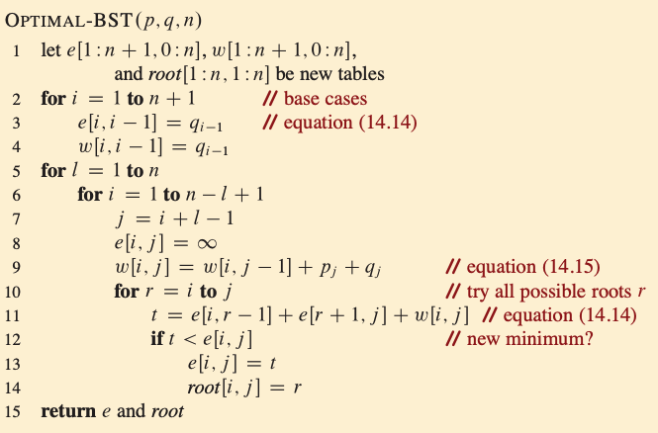

Solving optimal binary tree problem
Step 3:computing the expected search cost of an optimal binary search tree
The procedure takes $Θ(n^{3})$ time, just like matrix chain order.

Slide 13
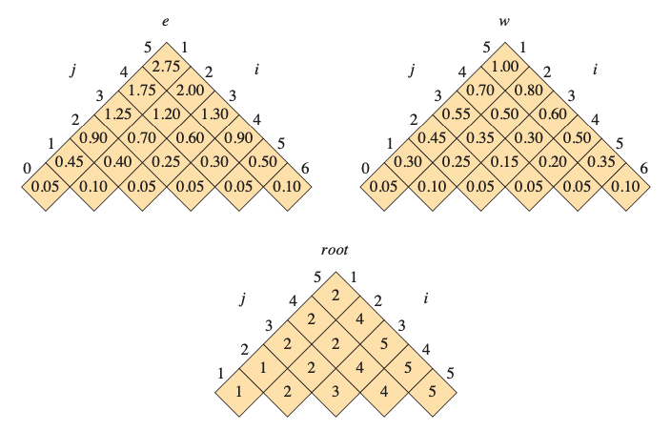
Solving optimal binary tree problem
Step 3:computing the expected search cost of an optimal binary search tree
The table e, w, and root computed by OPTIMAL-BST on the key distribution shown in slide 7.

Slide 14
Exercises
18
Write pseudocode for the procedure CONSTRUCT-OPTIMAL-BST(root,n) which, given the table root[1:n, 1:n], outputs the structure of an optimal binary search tree. For the example in previous figure, your procedure should print out the structure:
K2 is the root
K1 is the left child of k2
D0 is the left child of k1
D1 is the right child of k1
K5 is the right child of k2
K4 is the left child of k5
K3 is the left child of k4
D2 is the left child of k3
D3 is the right child of k3
D4 is the right child of k4
D5 is the right child of k5

Slide 15
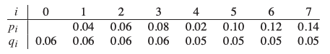
Exercises
18
Determine the cost and structure of an optimal binary search tree for a set of n = 7 keys with the following probabilities:
Suppose that instead of maintaining the table w[i, j], you computed the value of w[i, j] directly from equation of w(i, j) (slide 10) in line 9 of OPTIMAL-BST and used this computed value in line 11. How would this change affect the asymptotic running time of OPTIMAL-BST?

Slide 16
References
Thomas H. Cormen. (2022). Introduction to algorithms: Fourth edition. The MIT Press. Chapter 14.

Slide 17
Thank you
Dynamic programming: Optimal binary search tree
September, 2023

